Slide 1
Nutrition and Wandering
The degree to which nutrition can gate the wandering behavior of Ostrinia nubilalis univoltine-Z strain larvae. What effect does nutrition availability have on the digestive efficiency of 5th instar ECB larvae.

Slide 2
Sampling Design
Plot: long day (16:8) and short day (12:12)
Subplot:
Feeding ad libitum
24 hour depravation
48 hour depravation
72 hour depravation
96 hour depravation
120 hour depravation
Progression through 5th instar tracked using a “surveillance” population between 20 larvae
Day one of 5th instar
Wandering day
Diapause day 10
Artificial diet limited my mass
All larvae starved for 30mins to assay for wandering and before being dried.
 | Experimental Design Goal
 | Univoltine-Z Diapause (12:12) | Univoltine-Z Non Diapause (16:8)
Ad libitum | 10 Larvae | 10 Larvae
Minus 1 day | 10 Larvae | 10 Larvae
Minus 2 days | 10 Larvae | 10 Larvae
Minus 3 days | 10 Larvae | 10 Larvae
Minus 4 days | 10 Larvae
Minus 5 days | 10 Larvae

Slide 4
Prediction 1: Changes in diet availibility has no effect on
Non Diapause
Diapause
NULL

Slide 5
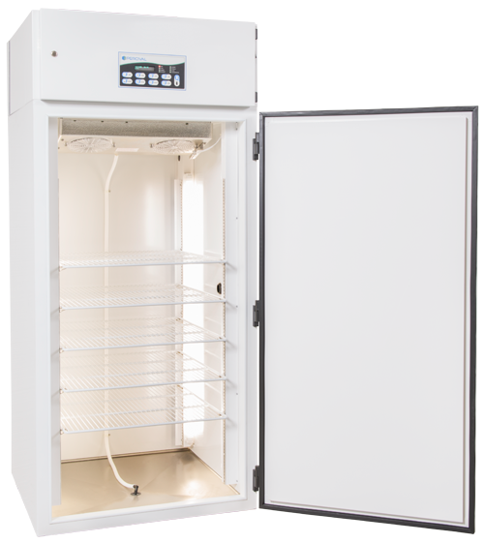
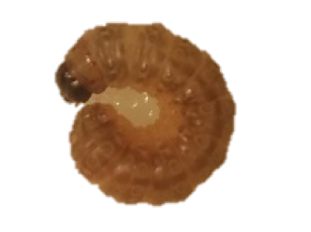
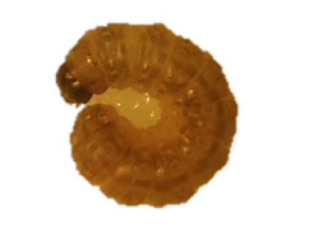
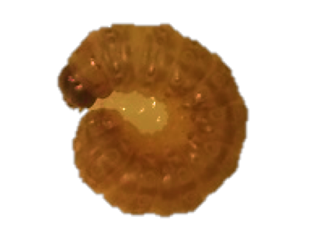
Summer
Fall
Short Diapause
Long Diapause
Prediction 2: Stored resources increased in diapausing larvae
Non-Diapause
Diapause

Slide 6
Summer
Fall
Short Diapause
Long Diapause
Prediction 3: Stored resources differs by photoperiod and ecotype
Non-Diapause
Diapause

